Slide 1

Zodiac Matching
Ethan Jewell

Slide 2
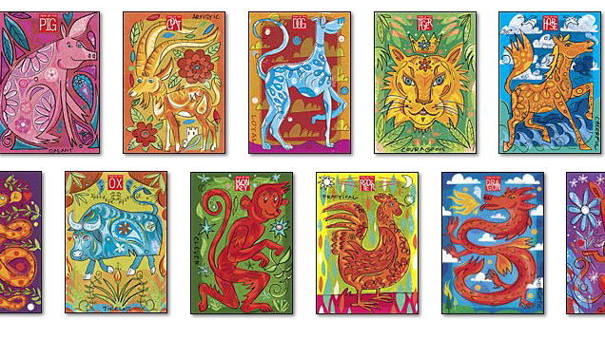
Description
Matching card game
Chinese zodiac themed
A match gives a point
Once all cards are gone the game is over

Slide 3
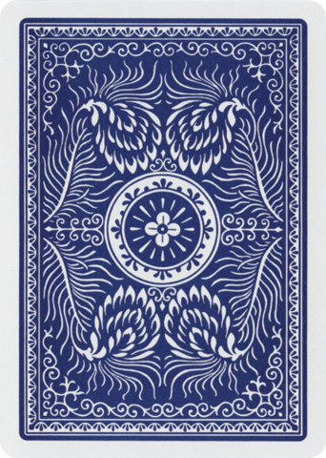
Biggest Challenge
Determining when two cards are flipped and which cards

Slide 4
Future Work
Cards worth different points
Different arrangements of cards
AI opponent

Slide 5
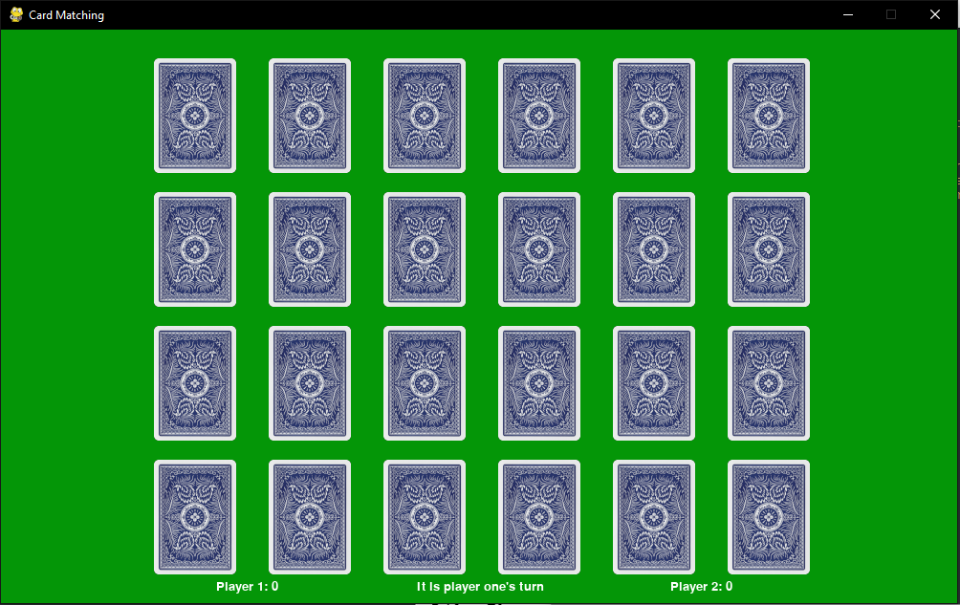
Enjoy My Game!
And a special thank you to everyone who helped make this game and camp possible, it was a fun three weeks!

